Slide 1



Domestic Violence Analysis
Using Power BI to analyze domestic violence patterns, identify risk factors , and support data - driven decisions.
DOMESTIC VIOLENCE
POWER BI
DATA ANALYTICS
Notes:
1.7.2013
1
‹#›

Slide 2


Introduction
Domestic violence is one of the most pressing social challenges worldwide, affecting millions of individuals across all demographics. This project leverages Power BI to transform raw survey data into visual, interactive insights — helping researchers, policymakers, and social workers identify patterns and prioritize interventions.
This analysis is based on anonymized national survey data covering victim demographics, employment, education, and marital status.
Notes:
1.7.2013
2
‹#›

Slide 3



Project Objectives
1
2
Quantify the Scope
Identify Vulnerable Groups
Measure total reported domestic violence cases across demographic segments.
Determine which age groups, employment statuses, and education levels are most affected.
3
4
Visualize Risk Factors
Support Decision-Making
Use Power BI dashboards to reveal correlations between marital status, income, and violence rates.
Provide data-driven recommendations for social programs and policy interventions.
Notes:
1.7.2013
3
‹#›

Slide 4



Dataset Description
The analysis is built on a domestic violence survey dataset containing demographic and social information. The dataset includes age, education, employment, income, marital status, and violence status variables to identify important patterns and relationships using Power BI.
📊 Records
🔢 Variables
📅 Dataset Information
347 survey records
Age
Education
Employment
Income
Marital Status
Violence Status
Total Records: 347
Violence Cases: 86
Average Age: 31.38 years
Notes:
1.7.2013
4
‹#›

Slide 5




Tools & Technologies Used
Power BI Desktop
Excel / CSV
Primary tool for data modeling, visualization, and interactive dashboard creation.
Raw data import, initial cleaning, and transformation before loading into Power BI.
DAX Formulas
Power Query
Data Analysis Expressions used for custom calculations, measures, and KPIs.
Used for data cleaning, transformation, and preparing the dataset before visualization.
Notes:
1.7.2013
5
‹#›

Slide 6
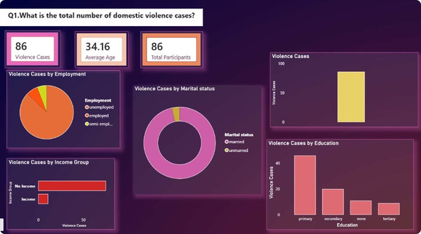
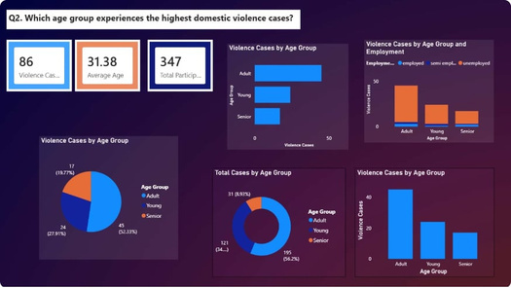
Q1
Total Domestic Violence Cases
The dashboard below presents the total number of domestic violence cases based on age, education, employment, income, and marital status.
Key Metrics to Highlight
• Total domestic violence cases: 86
• Average participant age: 34.16 years
• Higher cases among unemployed participants
• Primary education group shows more cases
Age Group with the Highest Domestic Violence Cases
This visualization identifies the age groups with the highest number of domestic violence cases and compares the distribution of cases across different age categories.
Analysis Focus
• Identify the age group with the highest number of cases.
• Compare domestic violence cases among Adult, Young, and Senior groups.
• Support targeted interventions for vulnerable age groups.
Key Findings
Adult group reported 45 cases (52.33%).
Young group reported 24 cases (27.91%).
Senior group reported 17 cases (19.77%).
Adults were the most affected age category.
Notes:
1.7.2013
6
‹#›

Slide 7
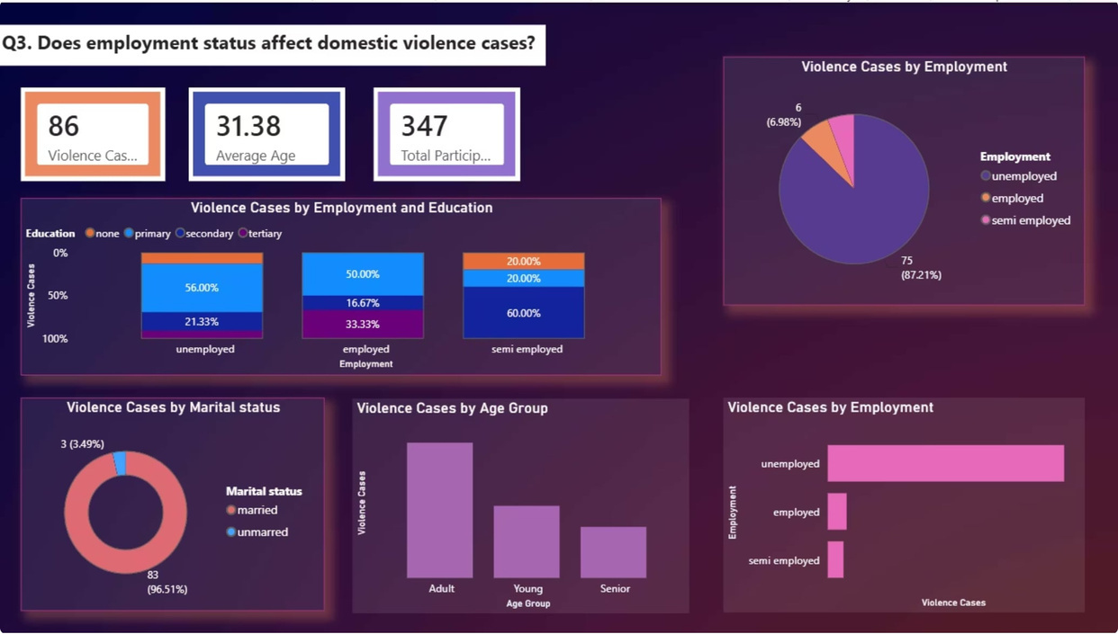
Q3
Effect of Employment Status
Employment status plays an important role in domestic violence cases. This analysis examines the relationship between employment categories and reported violence cases.
Analysis Focus
• Compare domestic violence cases across employment groups.
• Identify the employment category with the highest cases.
• Analyze the relationship between employment status and violence.
• Support socioeconomic risk assessment.
Categories Analyzed
• Unemployed individuals
• Employed individuals
• Semi-employed individuals
Key Findings
• Unemployed individuals reported 75 cases (87.21%).
• Employed individuals reported 6 cases (6.98%).
• Semi-employed individuals reported 5 cases (5.81%).
• Unemployment appears to be strongly associated with higher domestic violence cases.
Conclusion
Unemployment is strongly associated with higher domestic violence cases in the dataset.
Notes:
1.7.2013
7
‹#›

Slide 8
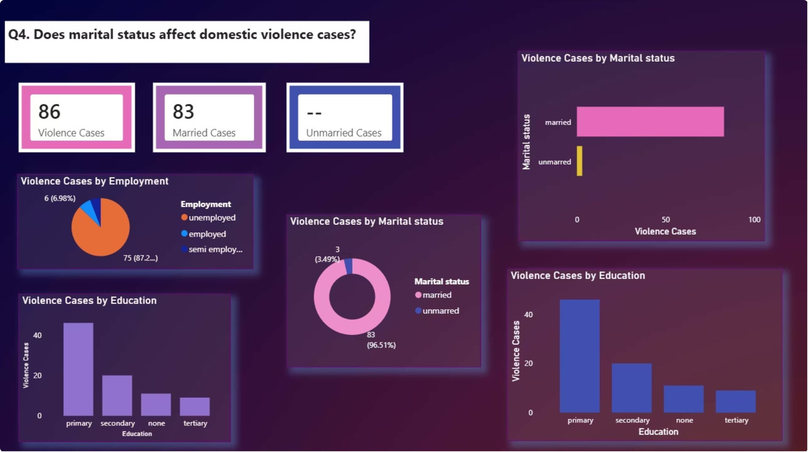
Q4
Effect of Marital Status
This section analyzes whether marital status influences the occurrence of domestic violence cases among participants.
Groups Compared
• Married individuals
• Unmarried individuals
Analysis Focus
• Compare domestic violence cases between married and unmarried individuals.
• Identify the marital group with the highest number of cases.
• Analyze the relationship between marital status and violence.
• Support data-driven social interventions.
Key Findings
• Married individuals reported 83 cases (96.51%).
• Unmarried individuals reported 3 cases (3.49%).
• Married participants accounted for the majority of reported cases.
• Marital status appears to influence domestic violence distribution.
Conclusion
The analysis indicates that married individuals experienced significantly higher domestic violence cases compared to unmarried individuals, making marital status an important factor in understanding domestic violence patterns.
Notes:
1.7.2013
8
‹#›

Slide 9
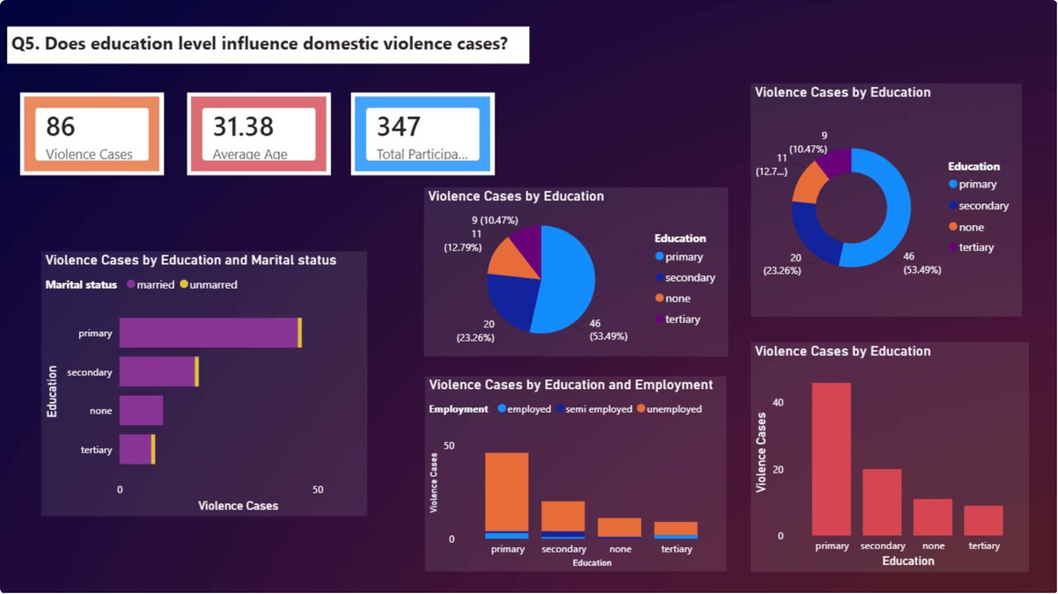
Q5
Effect of Education Level
Education level is analyzed to understand its relationship with domestic violence reporting rates across different literacy and qualification tiers.
Education Tiers
• Primary Education
• Secondary Education
• No Formal Education
• Tertiary Education
Analysis Focus
• Compare domestic violence cases across education levels.
• Identify the education category with the highest number of cases.
• Analyze the relationship between education and domestic violence.
• Support awareness and educational intervention programs.
Key Findings
• Primary education reported 45 cases (52.33%).
• Secondary education reported 20 cases (23.26%).
• No formal education reported 12 cases (13.95%).
• Tertiary education reported 9 cases (10.47%).
• Primary education participants accounted for the majority of reported cases.
Conclusion
The analysis indicates that participants with primary education reported the highest number of domestic violence cases, suggesting that education level may influence domestic violence patterns.
Notes:
1.7.2013
9
‹#›

Slide 10
Overall Conclusion
Key Conclusions
A total of 86 domestic violence cases were reported.
Adults reported the highest number of cases.
Unemployed individuals experienced the highest incidence.
Married participants accounted for most reported cases.
Primary education participants showed the highest case count.
Socioeconomic and demographic factors influence domestic violence patterns.
The analysis demonstrates that age, employment, marital status, and education level play an important role in domestic violence patterns and can support data-driven social interventions.
Notes:
1.7.2013
10
‹#›

